Slide 2
Use of Timers
TE2015 Microcontroladores

Slide 3
Operation of Timers
TE2015 Microcontroladores

Slide 4
CLOCK SWITCHING
System clock can be switched between internal and external sources using
New Oscillator Request (NOSC)
New Divider Selection Request (NDIV)
Clock Switch Enable configuration bit (CSWEN) enables clock switching
CSWEN = 1. Writes to NOSC and NDIV by software enable clock switching
CSWEN = 0. Writes to NOSC and NDIV are ignored
OSCILLATOR SOURCES
External Oscillator (EXTOSC)
EXTOSC with 4x PLL
High-Frequency Internal Oscillator (HFINTOSC)
Low-Frequency Internal Oscillator (LFINTOSC)
Secondary Oscillator (SOSC)

Slide 5
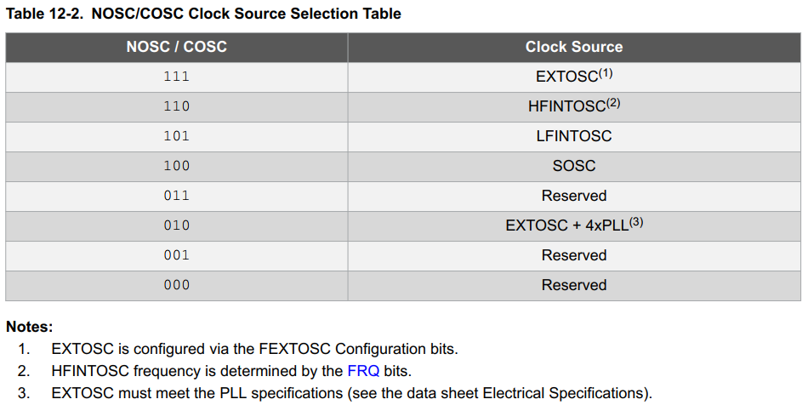
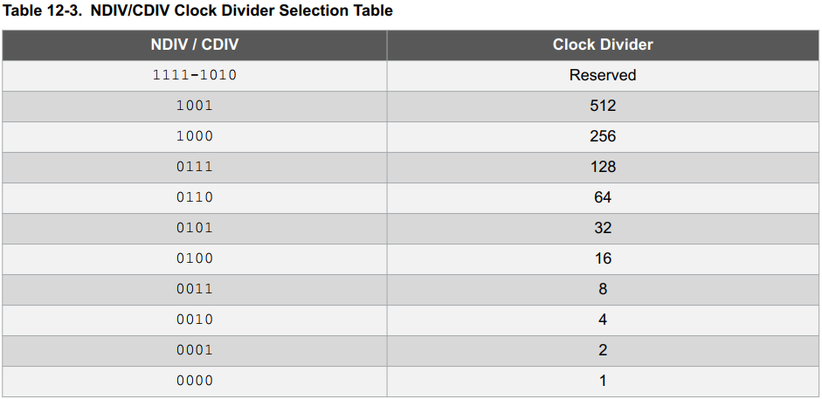
NOSC AND NDIV BITS
NOSC and NDIV are used to select the system clock source and clock frequency divider to be used by the CPU and peripherals
When new values are assigned to NOSC and NDIV, current oscillator keeps operating until new source indicates it is ready
The same applies when NDIV changes without changing NOSC (e.g. change in HFINTOSC frequency from 1 MHz to 2 MHz)
When the new oscillator source is ready:
New Oscillator is Ready bit, NOSCR is set: NOSCR = 1
Clock Switch Interrupt flag, CSWIF is set: CSWIF = 1
If Clock Switch Interrupt Enable, CSWIE, is set, CWSIE = 1, and interrupt is generated when CSWIF is set
Oscillator Ready (ORDY) can be polled to check if clock switching has completed and new oscillator source has replaced the system clock

Slide 6
COSC AND CDIV
Indicate the current oscillator source and clock divider, respectively:
COSC. Current Oscillator Source Select
CDIV. Current Divider Select

